Slide 1

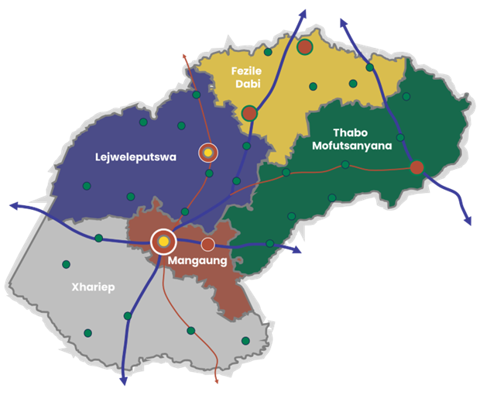


THE FREE STATE’S BROAD SPATIAL PLANNING DEVELOPMENT/PRIORITIES
as outlined in the National Development Framework:
MR CASPER BADENHORST
Maswana Group of Companies
FREE STATE
PROVINCIAL SPATIAL DEVELOPMENT FRAMEWORK

Slide 2
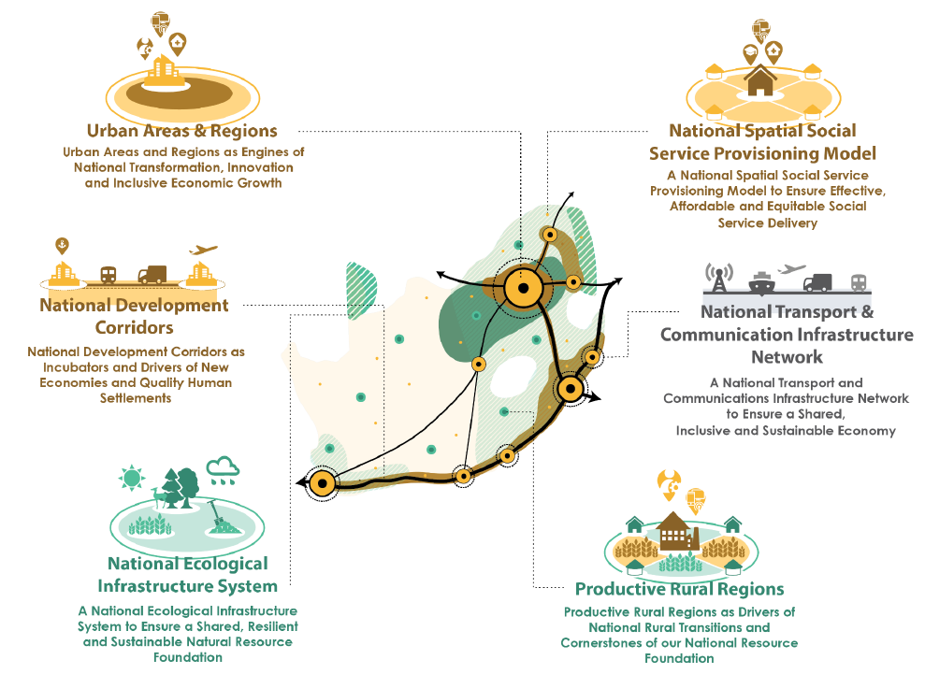

The National Spatial Development Framework (NSDF) provides the spatial expression of the NDP and MSTF strategies, indicating the preferred areas of investment for an array of sectors and industries
The NSDF will have a prominent impact on the Free State PSDF as the PSDF must directly align with the spatial development drivers and levers reflected in the NSDF.
The NSDF clusters spatial strategies into 4 subframe themes.
NATIONAL SPATIAL DEVELOPMENT LEVERS
1

Slide 3
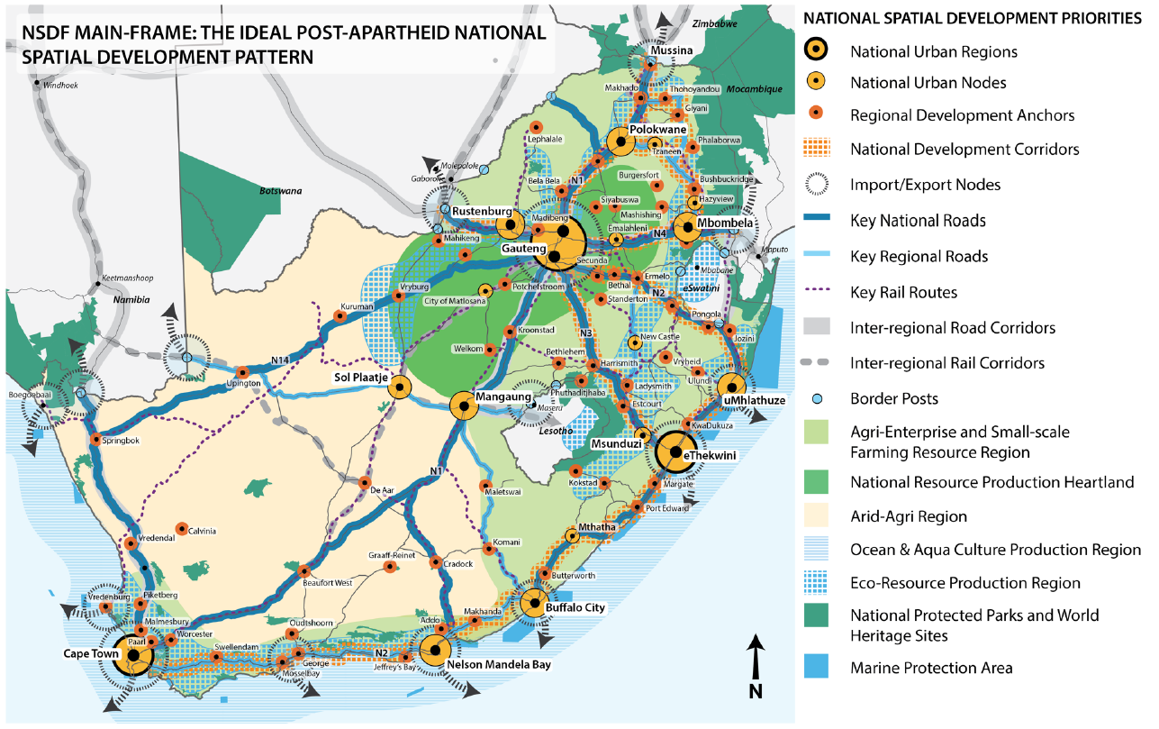
2

Slide 4
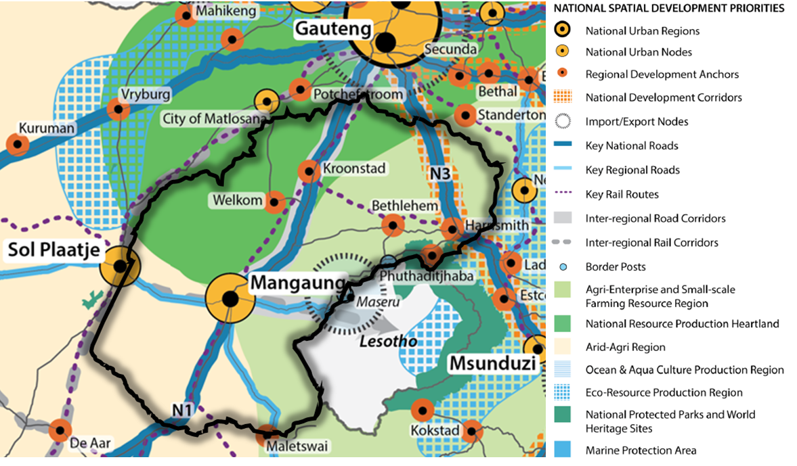
3

Slide 5
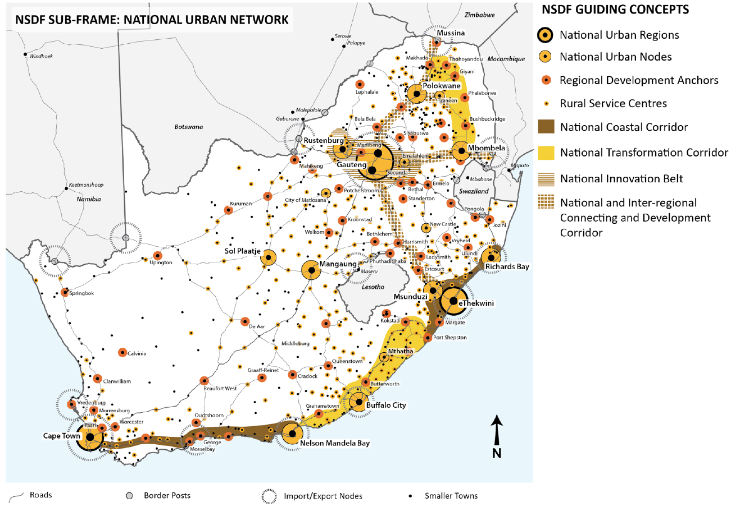
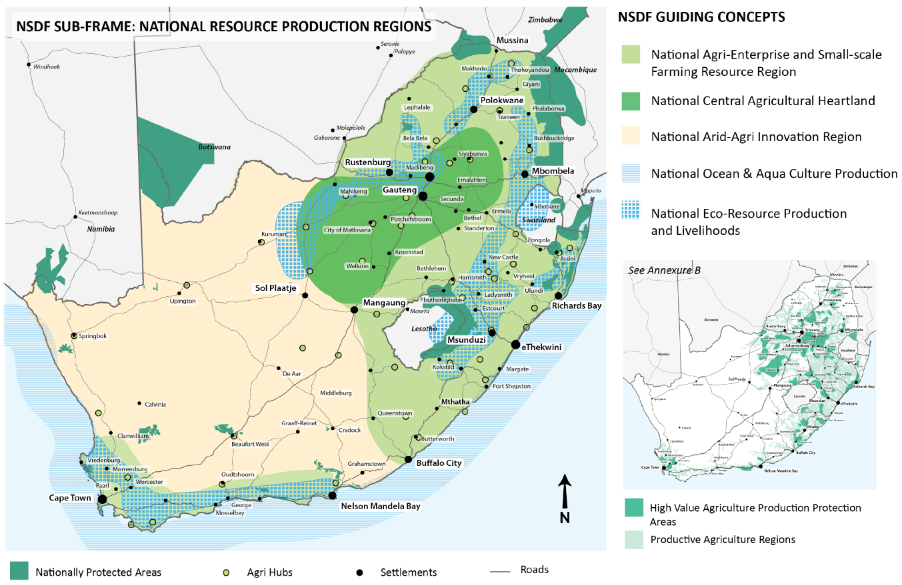
NSDF SUB-FRAME 1: NATIONAL URBAN NETWORK
4
NSDF SUB-FRAME 2: NATIONAL RESOURCE PRODUCTION REGIONS
Mangaung is classified as a National urban node.
The Sasolburg area falls within the Gauteng National Urban Region, which also forms part of the national innovation belt.
Kroonstad, Welkom Bethlehem, Harrismith and Phuthaditjhaba have been classified as regional development anchors
The northern regions of the Free State form part of the Central Agricultural Heartland as well as the Agri-Enterprise and Small-scale Farming Resource Region.
The southern regions of the province form part of the Arid-Agri Innovation Region.
The Eastern corner of the province falls within the Eco-Resource Production and livelihood region.

Slide 6
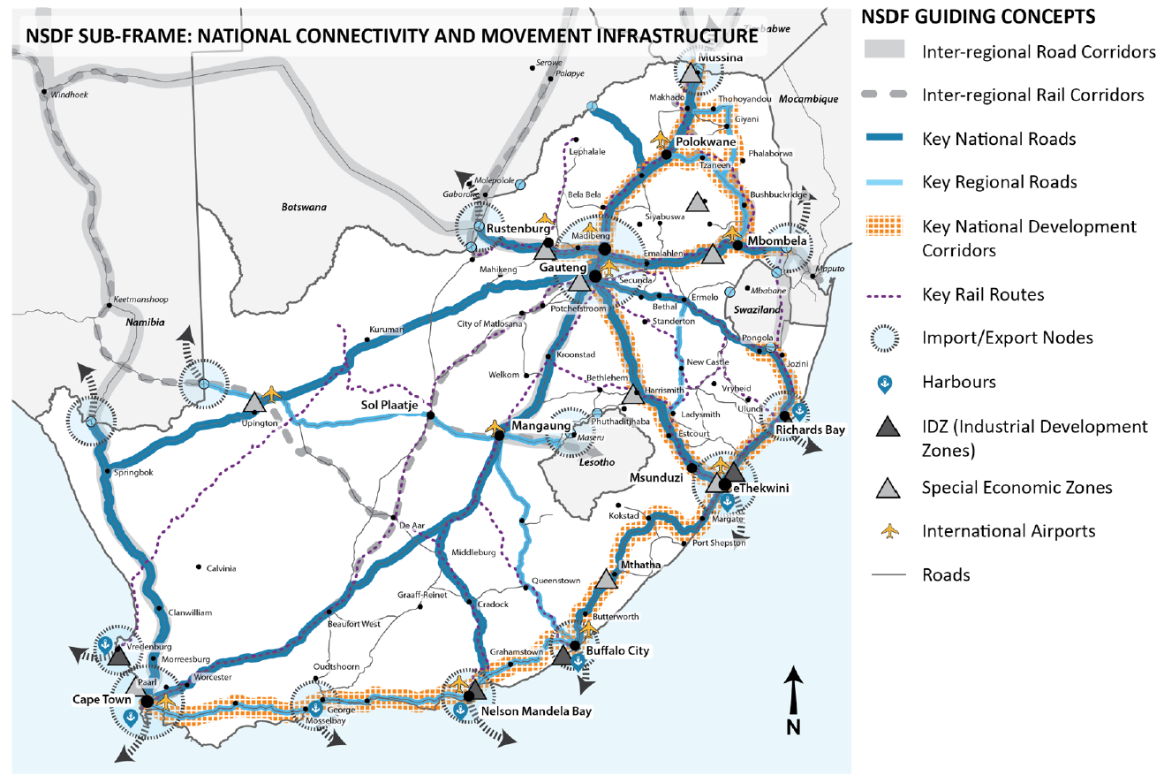
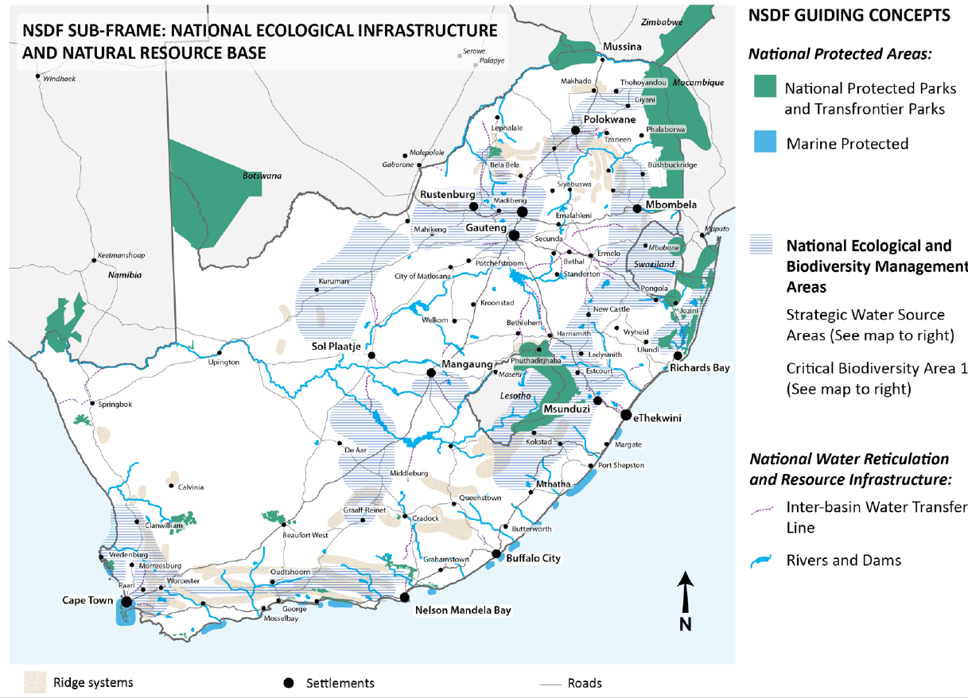
NSDF SUB-FRAME 3: NATIONAL CONNECTING AND MOVEMENT INFRASTRUCTURE
NSDF SUB-FRAME 4: NATIONAL ECOLOGICAL INFRASTRUCTURE AND NATURAL RESOURCE BASE
The N3 Durban–Free State–Gauteng route is highlighted as a Key National Development Corridor supported by the Maluti a Phofung SEZ.
The N1 is as a key national route.
Both the N6 and N8 are identified as key regional routes.
The Maseru border post and towns near the post have been identified as import and export nodes.
The Vaal and Orange form part of the National Water Reticulation and resource infrastructure.
The Vaal Central Water management area, as well as the Sasolburg and Parys region fall within the National Ecological and
Biodiversity Management Areas.
5

Slide 7
OBJECTIVE OF THE PSDF
The main objective is to DEVELOP, REFINE, and ADOPT a new CREDIBLE PSDF (as stipulated under Section 15 of the SPLUMA). The existing 2013 and reviewed 2018 PSDF as well as the FS PGDS will be used as a point of departure for this development. Key sub-objectives include:
To establish appropriate institutional mechanisms to promote spatial and land use management
To align the principles of SPLUMA
To address matters of Provincial Interest
To align and integrate with the FS PGDS, NSDF
To guide the preparation of SDFs for District and Local Municipalities in the Province
To present a common spatial agenda for development
Promote integrated development among stakeholders
To promote Sustainable Development.
To provide updated spatial and demographic data
KEY SCOPE :
Implementing a Sustainable Development pathway for the province.
To prepare and identify a future spatial distribution of land uses (especially towards protecting areas for agriculture and tourism development).
Prepare future development proposals
To provide investment direction and confidence in the province.
The PSDF needs to be aligned to the NSDF, NDP, FS PGDS, Karoo and Vaal RSDF, and the DALRRD SDF guidelines.
To promote a developmental state.
To prepare a SPLUMA-compliant PSDF.
To guide the space economy of the province
To align and give spatial structure
Implementation charter
A Monitoring and evaluation framework
A clear and concise institutional development framework
6

Slide 8
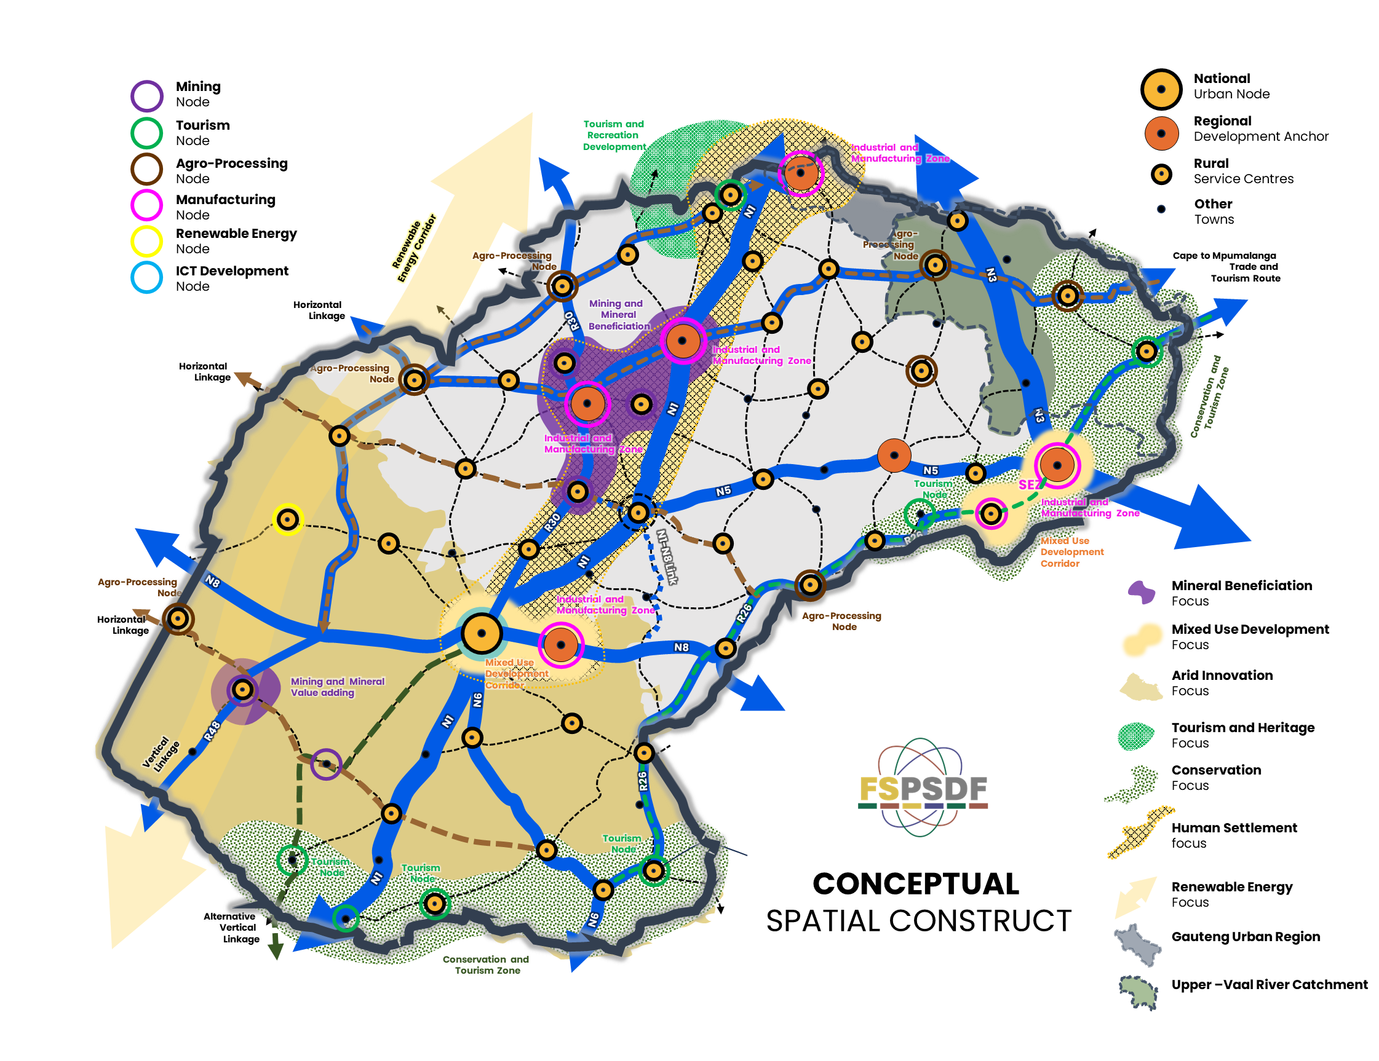
Linkages with VAAL SEZ
Vaal City Region
Petrochemicals Sector
Manufacturing
Industrial Development
Agro-processing
Human Settlement Development
Tourism Development
Maluti a Phofung SEZ
Transportation and Logistics
Food Processing
Agro-processing
Settlement Upgrading
Agro-Processing
Renewable Energy Development
Mining and Mineral Beneficiation
Industrial Development
Cargo and Logistics Development
Urban Regeneration
ICT Development
N8 Corridor Development
Linkages with Lesotho
Human Settlement Development
Industrial Development
Public Transportation
Commercial Development
Infrastructure Development
Knowledge Economy
7

Slide 9




THE FSPSDF IS TO TARGET THE IMPROVEMENT OF:
Investment Confidence
Institutional Capacity (fast- tracking of development applications)
Introduce a PRO-DEVELOPMENT and PRO-CONTROL philosophy through the provision of development zones
Access to information
Transparency in decision-making
www.fspsdf.co.za
8

