Slide 1

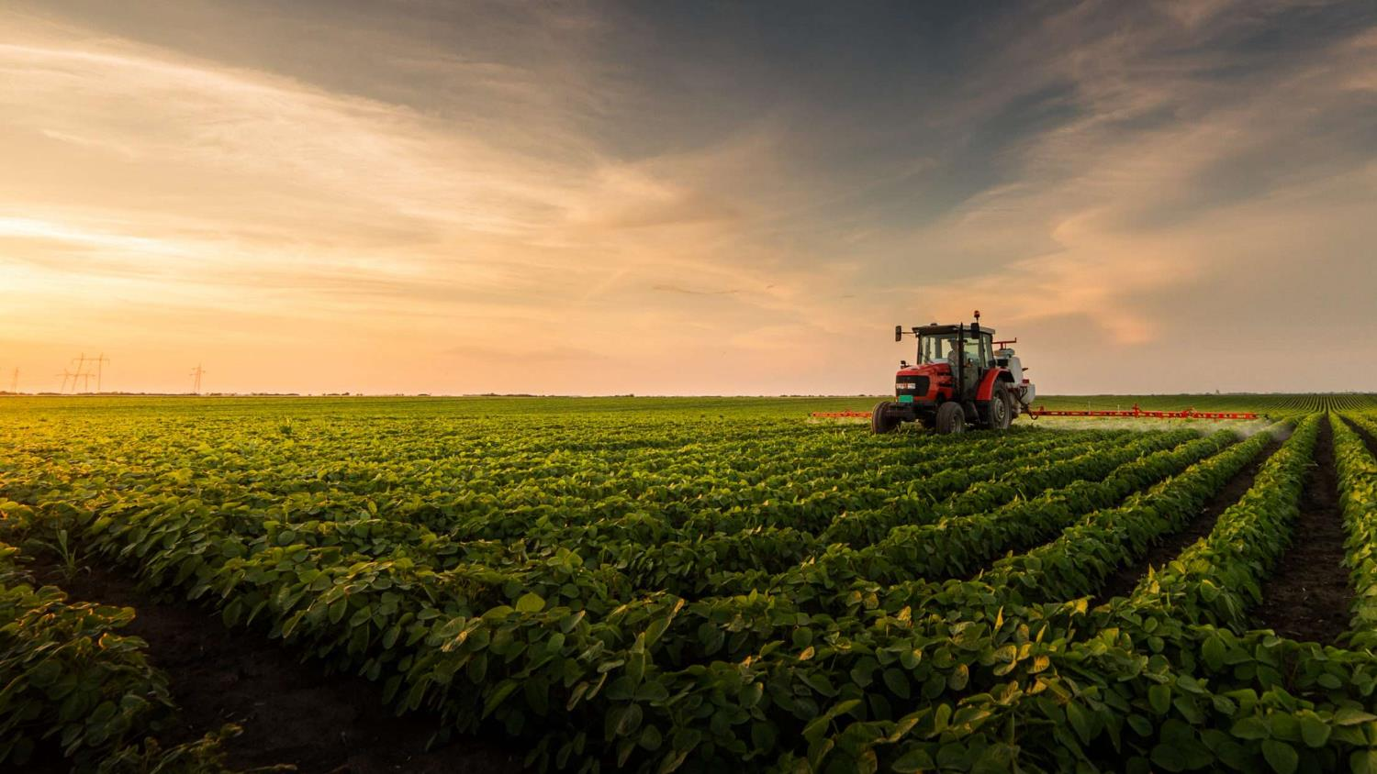



Free State Investment Conference
27 February 2024

Slide 2

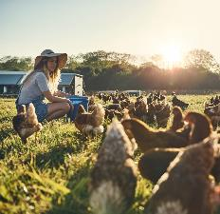
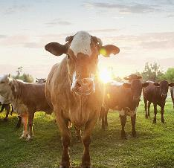

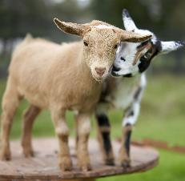
Free State Agriculture
Free State Agriculture is a a-political organisation celebrating 120 years in existence later this year and representing 2800 commercial farming entities in the agricultural sector in the Free State Province. A total of 146 farmers associations are affiliated to the organisation. These entities are responsible for a considerable input in the national food basket and also a significant source of employment especially in the rural areas of the province. The organisation is affiliated to Agri SA as a member of the Provincial Chamber.

Slide 3
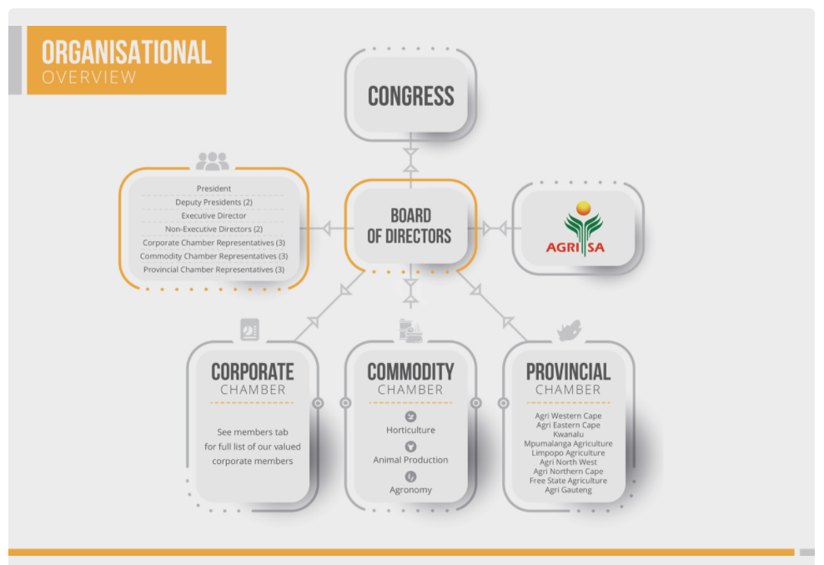
Agri SA structure

Slide 4
Topic: Investment in agricultural infrastructure and technology to improve competitiveness
Investment in agricultural infrastructure and technology is essential for enhancing the competitiveness of the agricultural sector. The sector is significantly cost effective at relieving poverty and has the potential to increase employment.
1.Enhanced Productivity:
  Technology Adoption: Implementing advanced agricultural technologies like precision farming, automation, and remote sensing can increase efficiency and yield. We have seen driverless tractors and huge strides in modernisation which is yielding tremendous results on productiveness.
  Infrastructure Upgrades: On farm: Modernising irrigation systems, farm machinery, and storage facilities can significantly boost productivity. Off farm: This is where government and investors can play a tremendous role. Examples: energy, roads, railways, telecoms, ports. Challenges relating to these examples are experienced on a daily basis and is negatively impacting on the sector and the economy as a whole.

Slide 5
Topic: Investment in agricultural infrastructure and technology to improve competitiveness
2.Access to Markets:
  Transportation Infrastructure: Developing and maintaining roads, bridges, and ports improves the transportation of agricultural goods to markets, reducing transportation costs and time. The focus should not only be on upgrades and development, maintenance plays a crucial role in the process.
  Market Information Systems: Investing in systems that provide real-time market information helps farmers make informed decisions about what and when to produce and sell. The farmer of today on a daily basis must make informed decisions based on sound business principles in order to ensure sustainability.
3.Water Management:
  Irrigation Infrastructure: Upgrading irrigation systems such as drip irrigation and sprinkler systems can help conserve water and improve crop yields. 6x multiplier.
  Water Storage Facilities: Constructing reservoirs and dams helps to mitigate the impacts of drought and ensure a reliable water supply for agriculture.

Slide 6
Topic: Investment in agricultural infrastructure and technology to improve competitiveness
4.Research and Development:
  Innovation Centres: New technology needs to be developed and trialed locally by reputable research institutions to commercialize with confidence. The FS has top research institutions: UFS, CUT
  Projects FSA involved in: Energy farming; Biomass to gas, Waste to energy, irrigation efficiency, climate change adaptation, Just transition etc.
  Training Programs: Applied TRAINING in new ag. tech. is also critical – Bfn has UFS, CUT Motheo TVET College (Climate smart Agri), Glen agricultural College and various private colleges; i3A, Peritum Agric Institute, Vrystaat Landbou College, etc. producing many unemployed graduates
  Glen College has 4600ha at their disposal inc. 40ha irrigation rights that needs investment to offer students practical farming training in lates methods & tech.

Slide 7

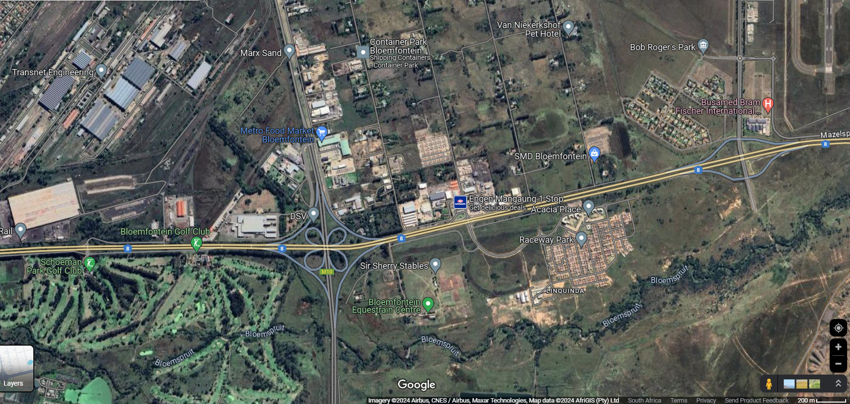
Potential Agro-Processing HUB east of Bfn:
Transnet vocation school empty & 20+ha vacant land
AIRPORT HUB
Abattoir
Fresh Produce Market
8ha State Nursery
250+ha vacant land beyond waste water treatment plant

Slide 8
Topic: Investment in agricultural infrastructure and technology to improve competitiveness
5.Digital Agriculture:
  Farm Management Software: Implementing digital tools and software for farm management, data analytics and decision support systems increases efficiency and productivity.
  Precision agriculture: Using sensors, drones and GPS technology allows for precise monitoring and management of crops and optimising resource use.
6.Financial Support: (Not just access to credit but full support services)
  Subsidies: Providing financial incentives and subsidised credit encourages farmers to invest in new technologies and infrastructure upgrades. The South African farmer must compete against farmers in other countries without the benefit of subsidies. This obviously is an impediment in improving competitiveness.
  Access to credit: Offering affordable credit and financing options enables farmers to invest in equipment, technology and infrastructure improvements. Although access to credit for developing farmers are crucial, commercial farmers should not be excluded / neglected.
Notes:
BFAP Baseline 2023 as reference

Slide 9
Topic: Investment in agricultural infrastructure and technology to improve competitiveness
7.Environmental Sustainability:
  Conservation Practices: Investing in farming practices such as regeneration / conservation agriculture and organic farming, promotes soil health and biodiversity. We are already seeing great advancements in these practices.
  Renewable energy: Deploying renewable energy sources like solar panels and wind turbines on farms reduces greenhouse gas emissions and energy costs.
  Carbon credit market still needs development in SA
8.Supply Chain Optimisation:
  Cold Chain Infrastructure: Developing cold storage, processing, and distribution facilities helps maintain the quality and freshness of perishable agricultural products, reducing post-harvest losses. Energy should be readily available to facilitate these processes and the role of investment cannot be underestimated.

Slide 10
Topic: Investment in agriculture and technology to improve competitiveness
Traceability Systems: Implementing traceability systems helps ensure food safety and quality. Recent challenges with biosecurity shows the importance thereof for competitiveness. FSA currently in process of rolling out traceability system in collaboration with Agri Eastern Cape that will assist livestock production farmers in the province both on farms and commonages.
Conclusion:
Investments in agricultural infrastructure and technology not only benefit farmers by increasing productivity and profitability but also contribute to food security, rural development, and economic growth. Government by developing and implementing positive policies and thus creating a conducive environment in which the economy can flourish, private sector investors, and development organisations play crucial roles in facilitating and financing these investments to create a more competitive and sustainable agricultural sector. No agriculture = no food.

Slide 11
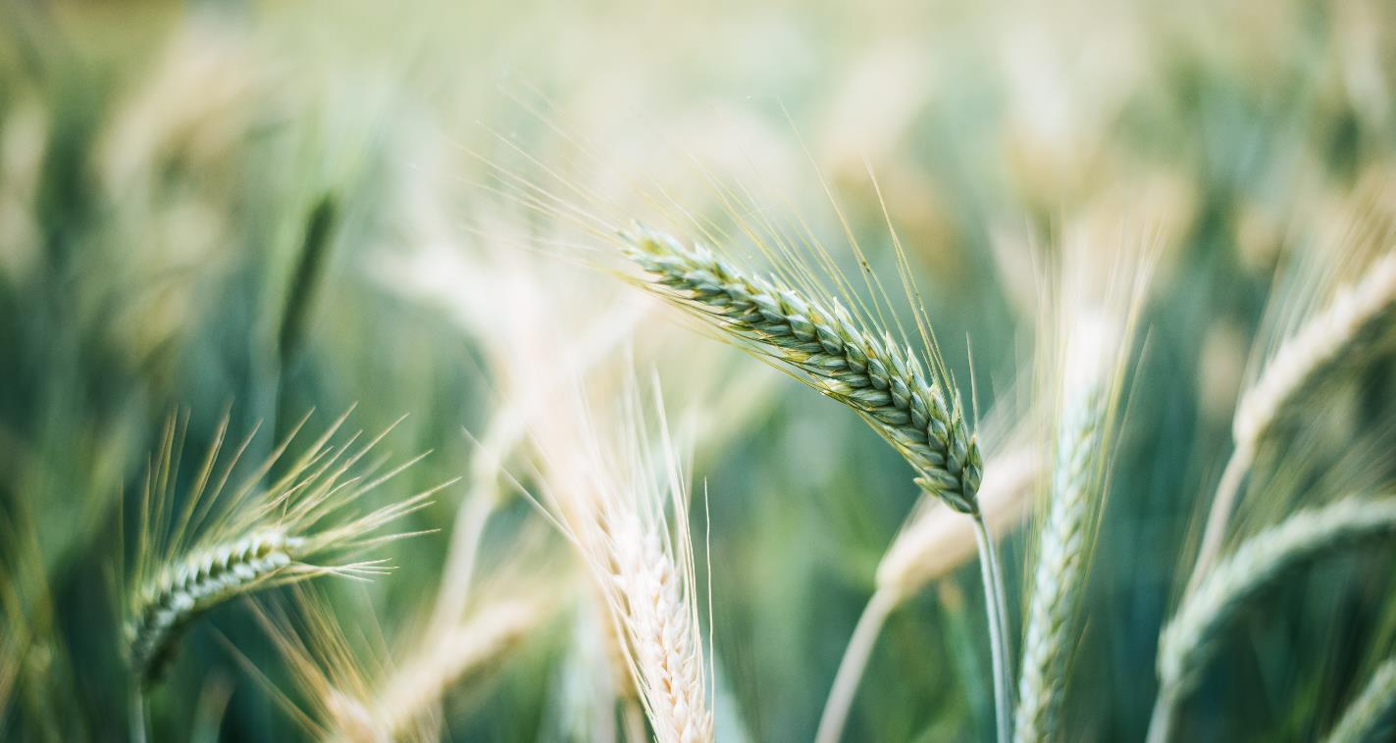

THANK YOU
V
Mr. Gernie Botha
CEO - Free State Agriculture
+27 51 444 4609
info@vslandbou.co.za

